Slide 1
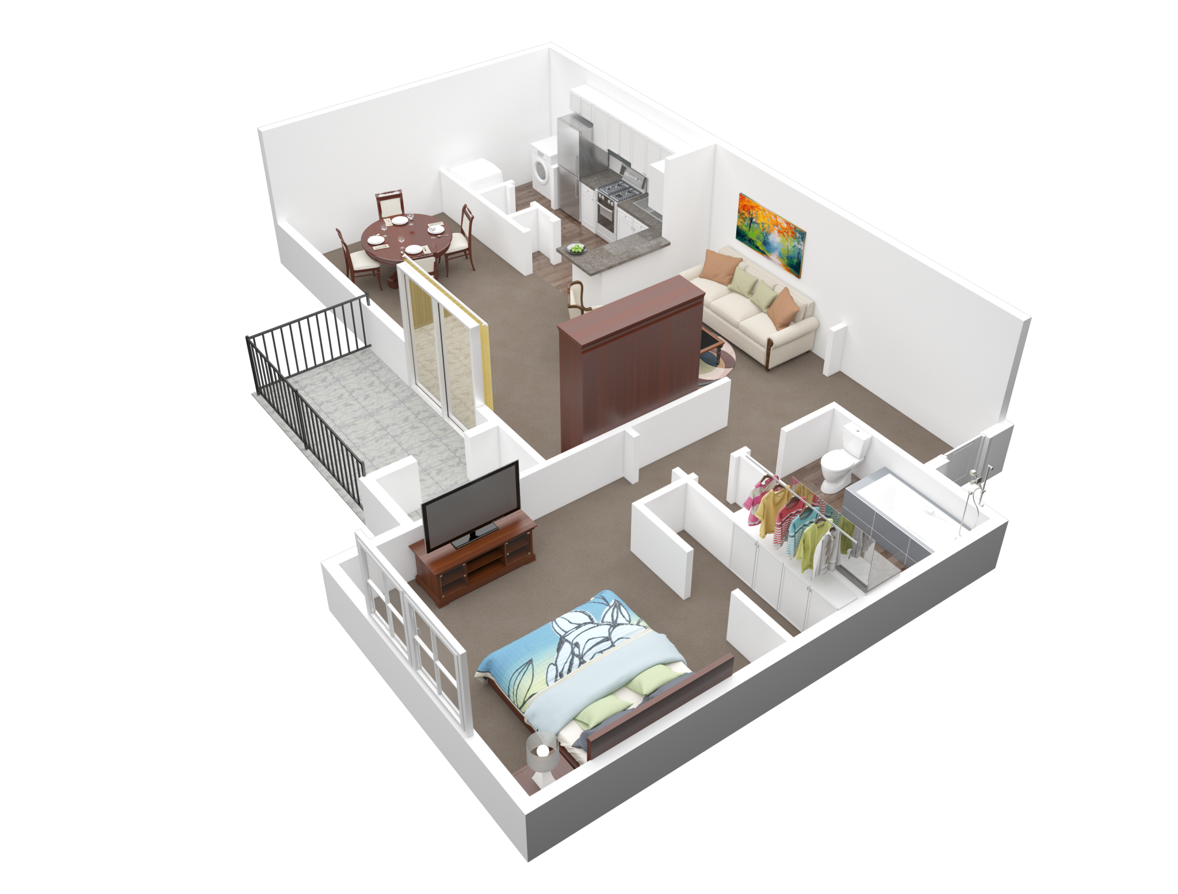

Apartment rental offers in Germany
Notes:
Presentation for the final lab…

Slide 2

What I have done…
01 Overview.ipynb
02 Data cleaning.ipynb
03 Data Analysis.ipynb
04 Berlin.ipynb
05 Search App.ipynb
06 Scaping.ipynb
07 Models
08 Models_cat.ipynb
09 Clusters.ipynb
10 more Models .ipynb
11 Text Analysis.ipynb

Slide 3
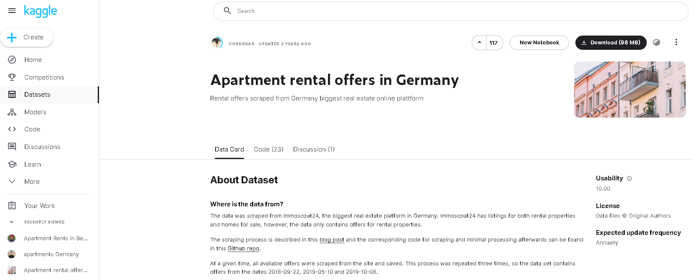
Data Source

Slide 4
Dataset
regio1
serviceCharge
heatingType
telekomTvOffer
telekomHybridUploadSpeed
newlyConst
balcony
picturecount
pricetrend
telekomUploadSpeed
totalRent
yearConstructed
scoutId
noParkSpaces
firingTypes
hasKitchen
geo_bln
cellar
yearConstructedRange
baseRent
houseNumber
livingSpace
geo_krs
condition
interiorQual
petsAllowed
street
streetPlain
lift
baseRentRange
typeOfFlat
geo_plz
noRooms
thermalChar
floor
numberOfFloors
noRoomsRange
garden
livingSpaceRange
regio2
regio3
description
facilities
heatingCosts
energyEfficiencyClass
lastRefurbish
electricityBasePrice
electricityKwhPrice
date
Euro/m2
price_class

Slide 5
Dataset
regio1
serviceCharge
heatingType
telekomTvOffer
telekomHybridUploadSpeed
newlyConst
balcony
picturecount
pricetrend
telekomUploadSpeed
totalRent
yearConstructed
scoutId
noParkSpaces
firingTypes
hasKitchen
geo_bln
cellar
yearConstructedRange
baseRent
houseNumber
livingSpace
geo_krs
condition
interiorQual
petsAllowed
street
streetPlain
lift
baseRentRange
typeOfFlat
geo_plz
noRooms
thermalChar
floor
numberOfFloors
noRoomsRange
garden
livingSpaceRange
regio2
regio3
description
facilities
heatingCosts
energyEfficiencyClass
lastRefurbish
electricityBasePrice
electricityKwhPrice
date
Euro/m2
price_class
49 columns
19x OBJECT
18x FLOAT64
6x INT64
6x BOOLEAN
268.850 rows
267.810 rows after cleaning
2.539.905 NaN-values
2 columns added

Slide 6
Dataset
regio1
serviceCharge
heatingType
telekomTvOffer
telekomHybridUploadSpeed
newlyConst
balcony
picturecount
pricetrend
telekomUploadSpeed
totalRent
yearConstructed
scoutId
noParkSpaces
firingTypes
hasKitchen
geo_bln
cellar
yearConstructedRange
baseRent
houseNumber
livingSpace
geo_krs
condition
interiorQual
petsAllowed
street
streetPlain
lift
baseRentRange
typeOfFlat
geo_plz
noRooms
thermalChar
floor
numberOfFloors
noRoomsRange
garden
livingSpaceRange
regio2
regio3
description
facilities
heatingCosts
energyEfficiencyClass
lastRefurbish
electricityBasePrice
electricityKwhPrice
date
Euro/m2
price_class
49 columns
19x OBJECT
18x FLOAT64
6x INT64
6x BOOLEAN
268.850 rows
267.810 rows after cleaning
2.539.905 NaN-values
2 columns added

Slide 7
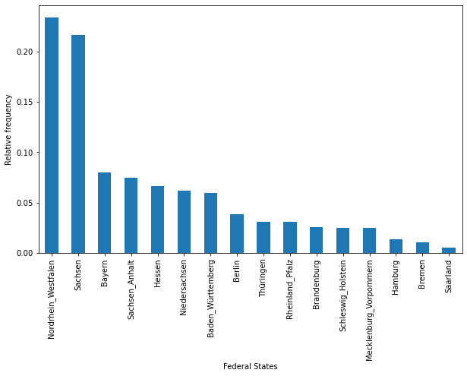
Data immoscout24.de

Slide 8
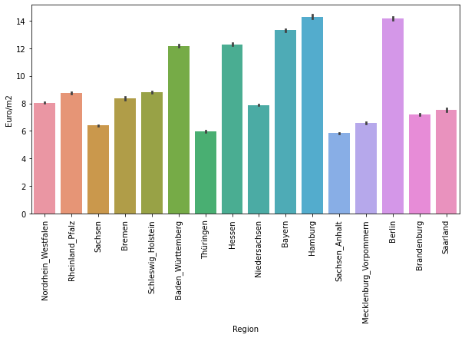


Data immoscout24.de

Slide 9
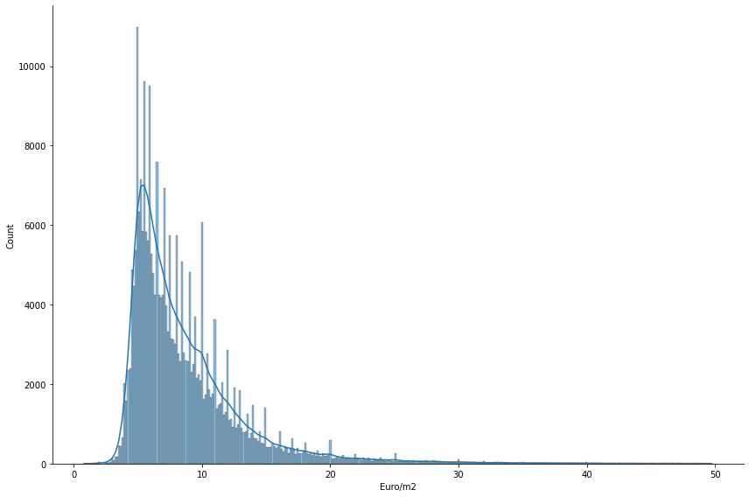
Data immoscout24.de
Notes:
Avg base rent in germany is 10.76 Euro/m²

Slide 10
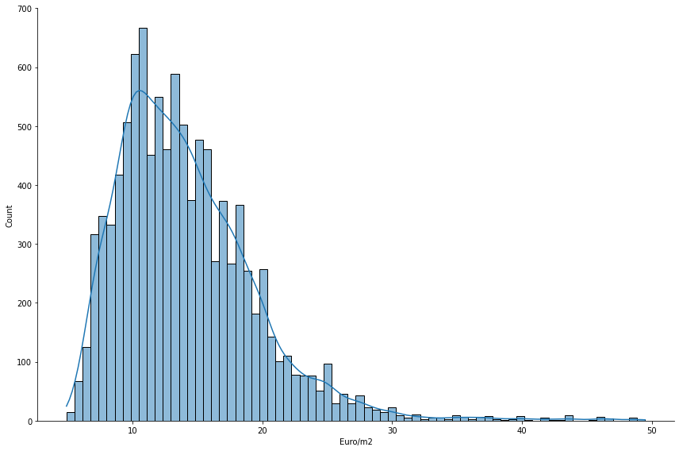
Data immoscout24.de
70-80% higher
in Berlin

Slide 11
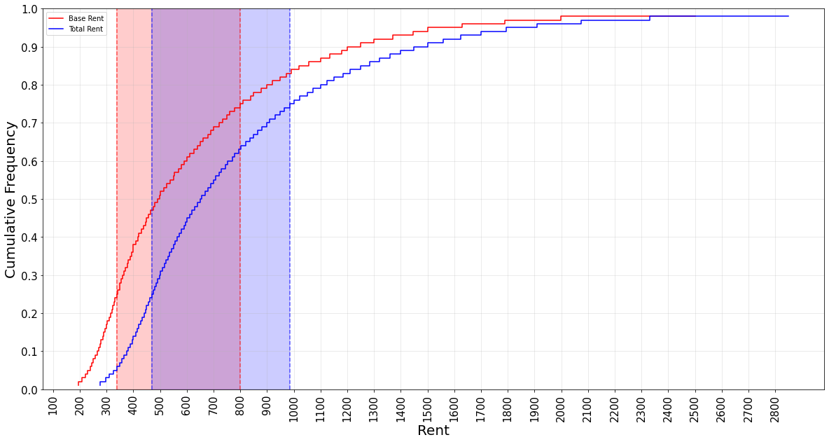
Data immoscout24.de

Slide 12
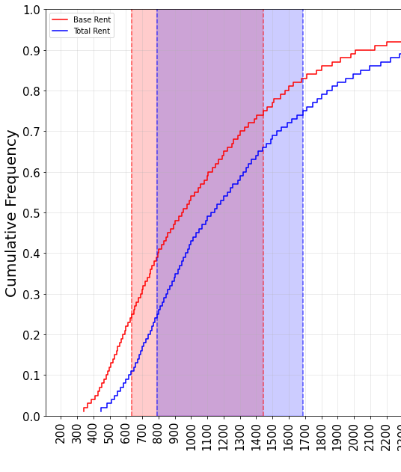
Data immoscout24.de
70-80% higher
in Berlin

Slide 13
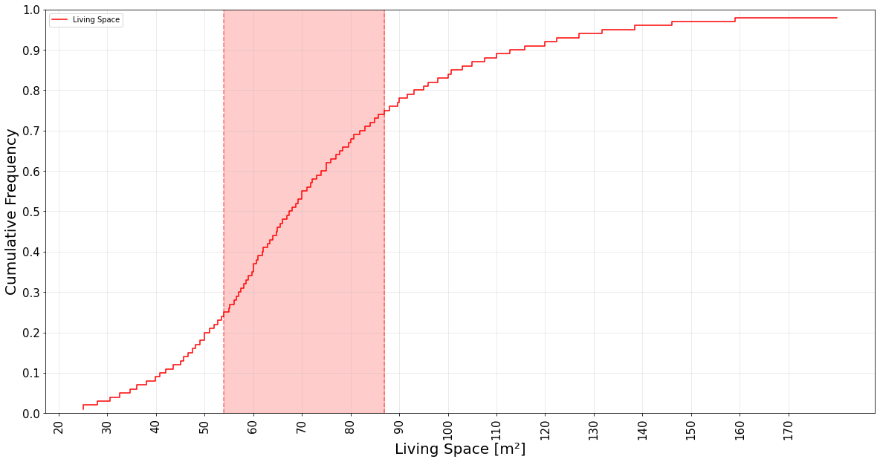
Data immoscout24.de

Slide 14
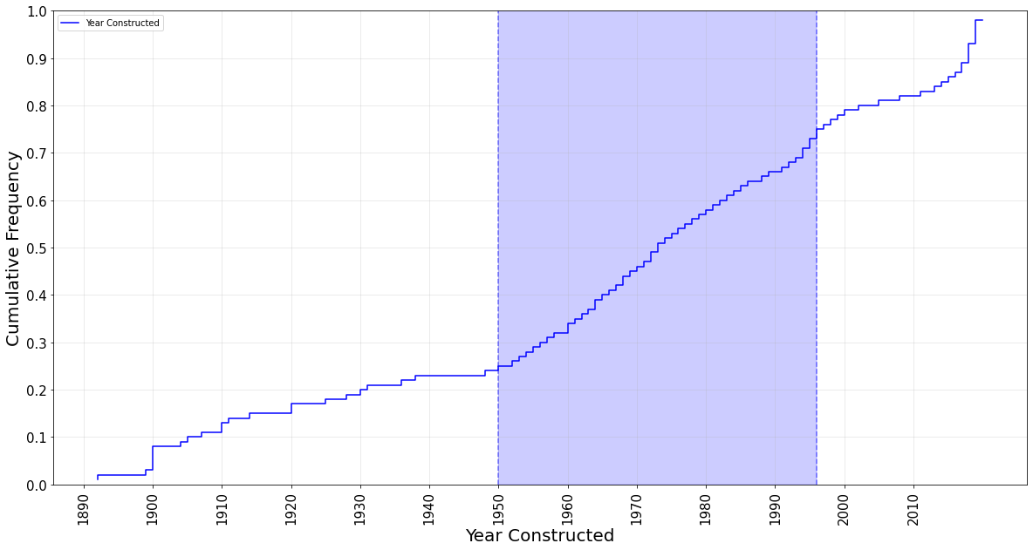
Data immoscout24.de

Slide 15
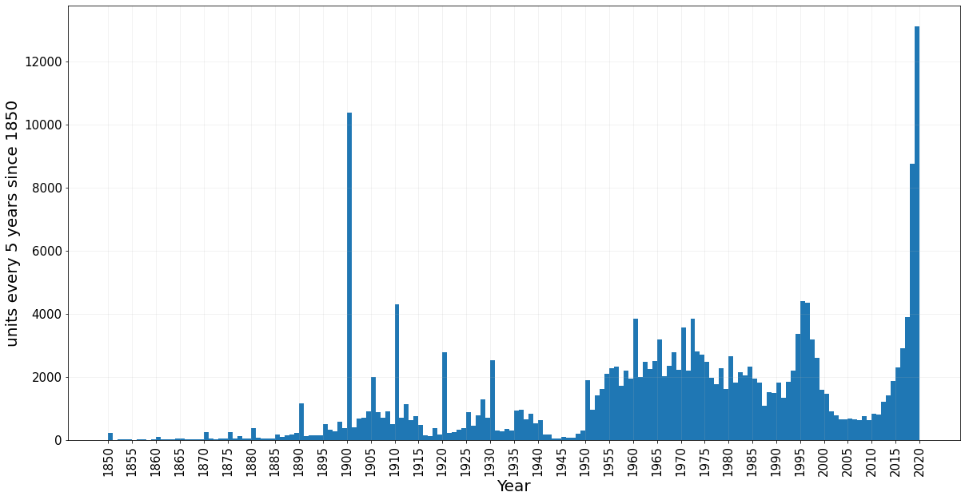
Data immoscout24.de

Slide 16
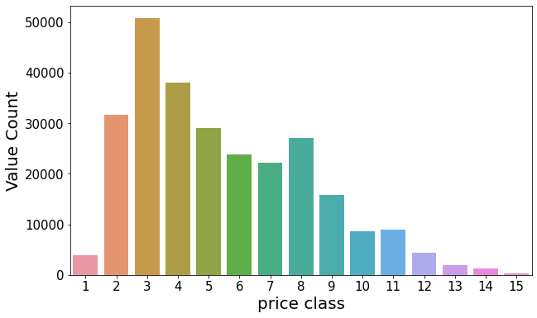
Data immoscout24.de

Slide 17
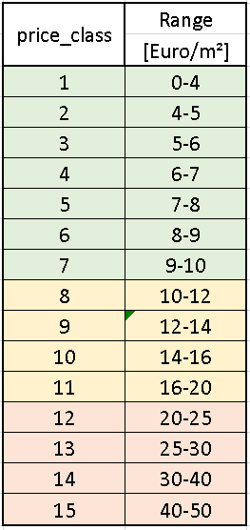
Data immoscout24.de
Notes:
18% of the data fall into priceclass 3

Slide 18
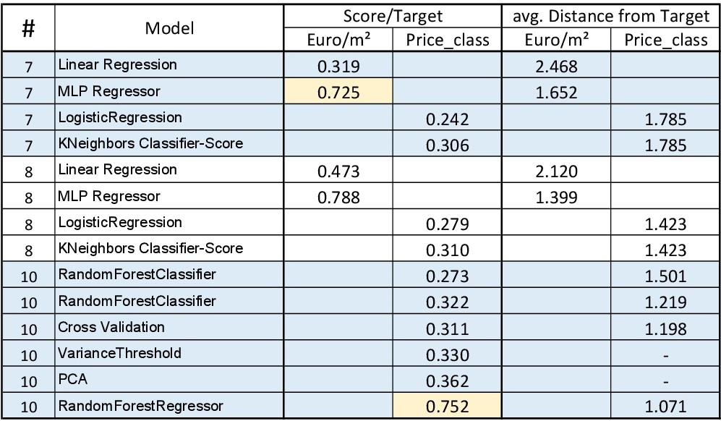
Models
Notes:
MLP Regressor (neural network) performs best with an acuracy of 79%
The Random Forest Regressor performs best on predicting the price_class

Slide 19
Models

Slide 20
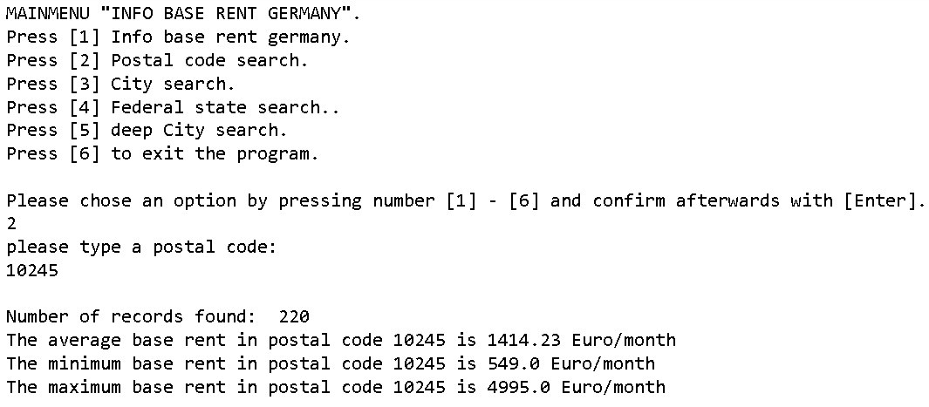
Search App

Slide 21


Slide 22
Additional content…

Slide 23
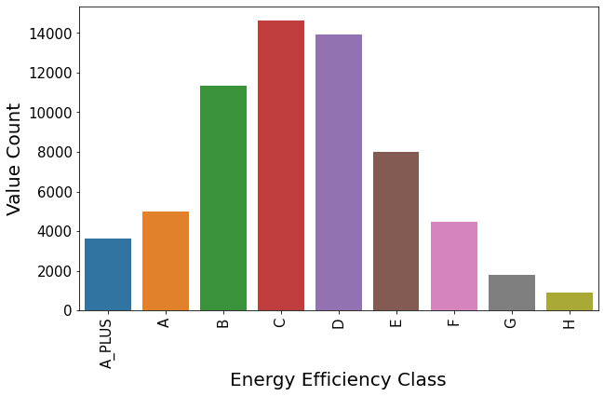
Data immoscout24.de

Slide 24
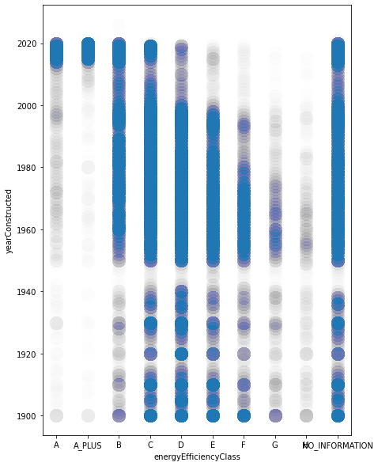
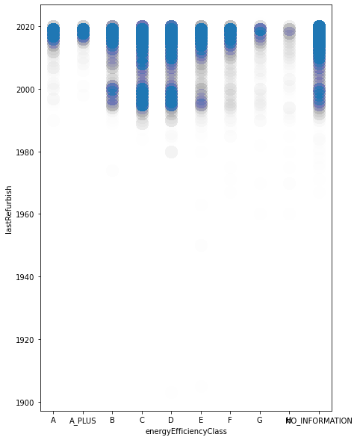
Data immoscout24.de

Slide 25
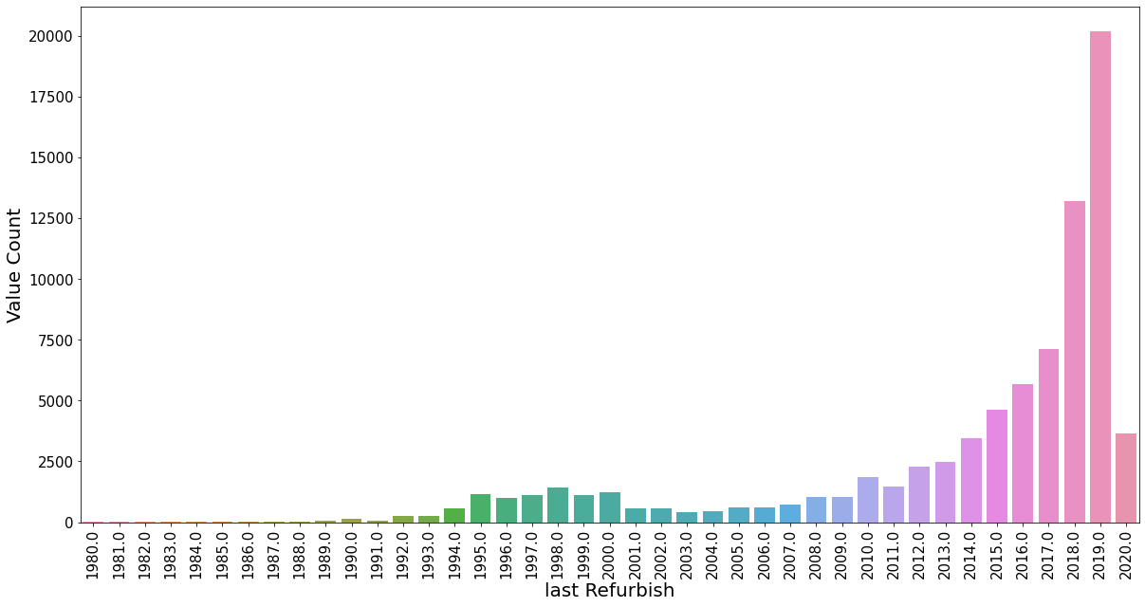
Data immoscout24.de

Slide 26
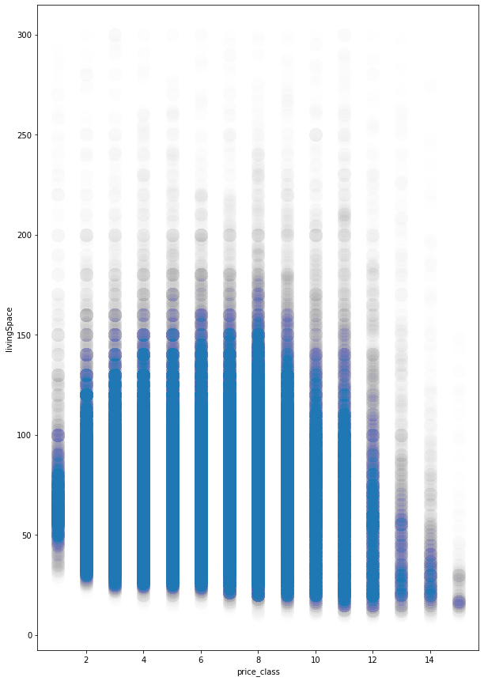
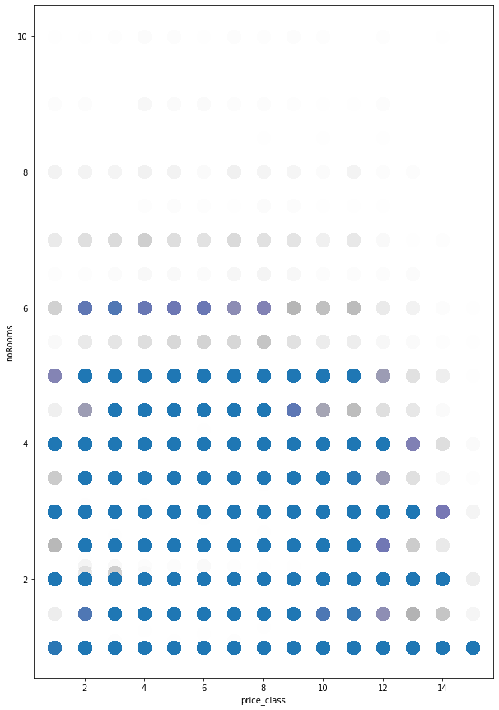
Data immoscout24.de

Slide 27
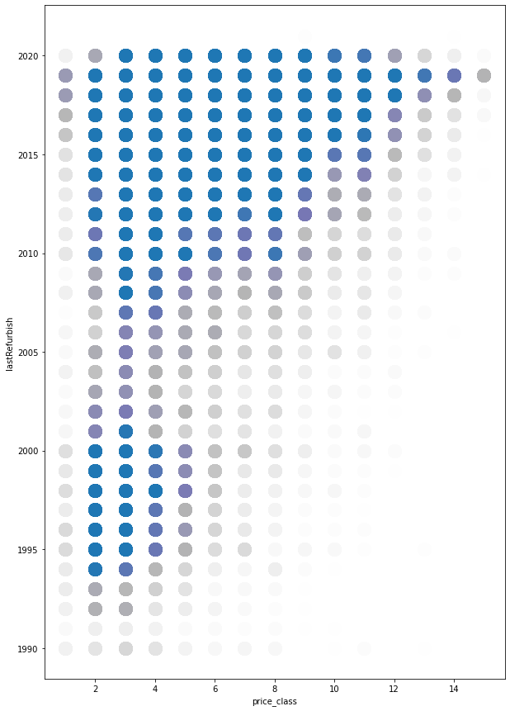
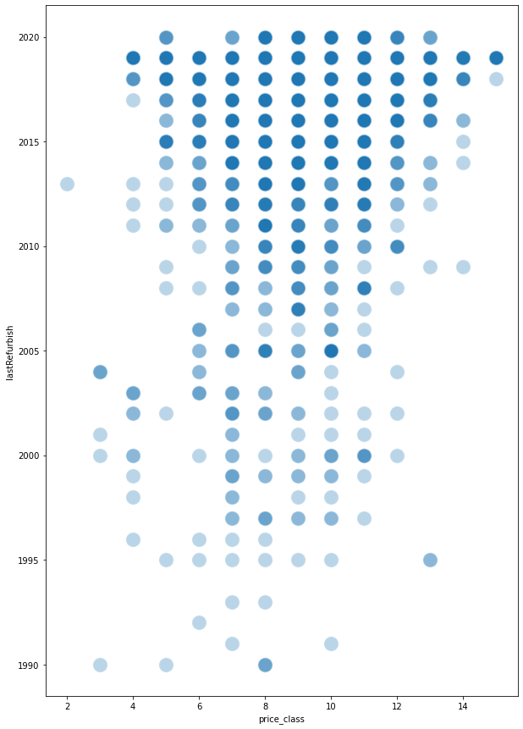
Data immoscout24.de

Slide 28
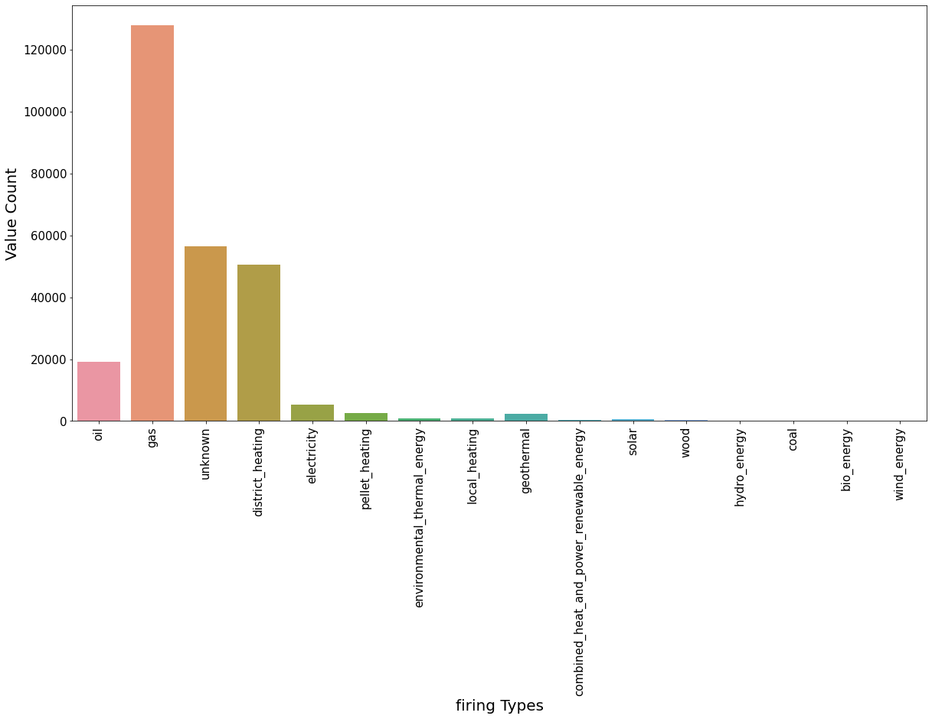
Data immoscout24.de

Slide 29
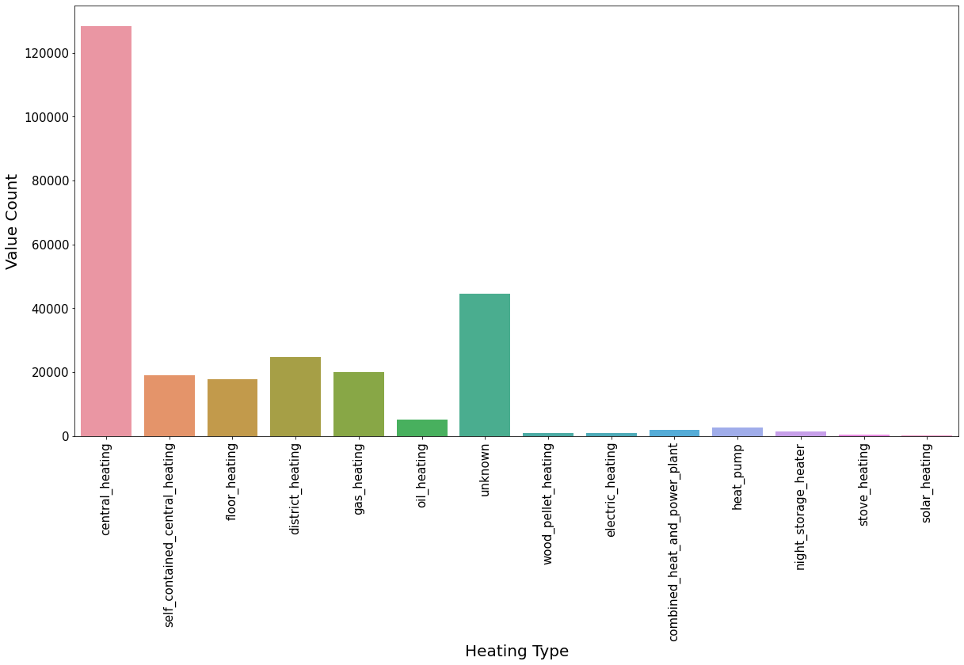
Data immoscout24.de

Slide 30
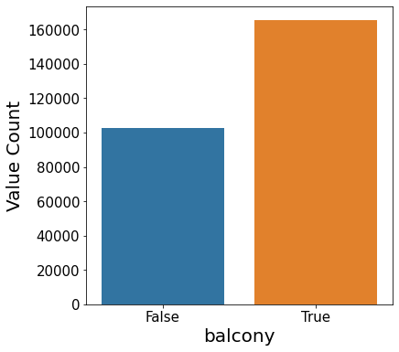
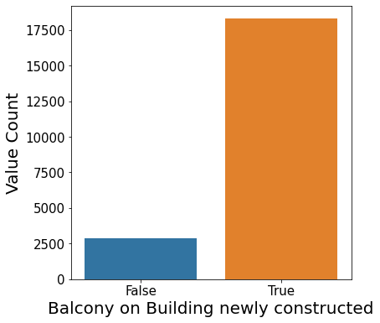
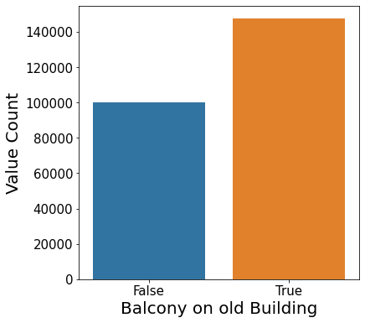
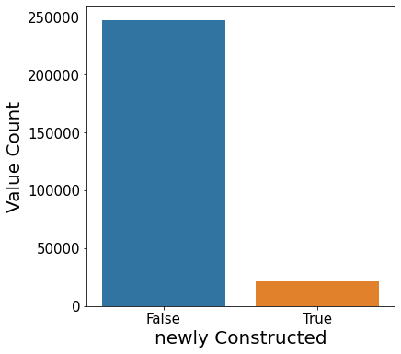
Data immoscout24.de

Slide 31
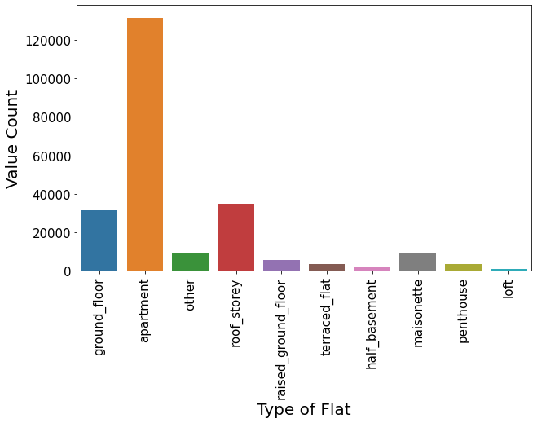
Data immoscout24.de

Slide 32
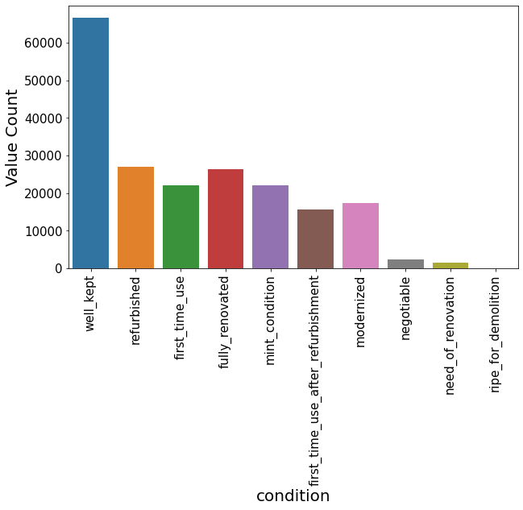
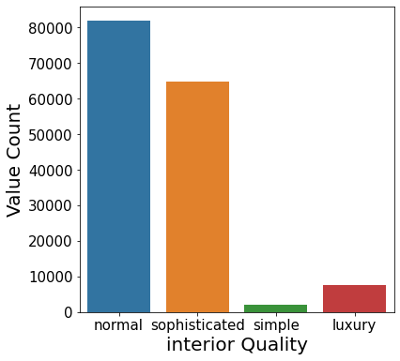
Data immoscout24.de

Slide 33
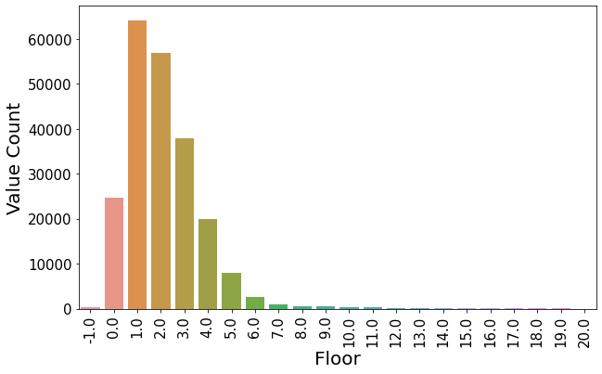
Data immoscout24.de

Slide 34
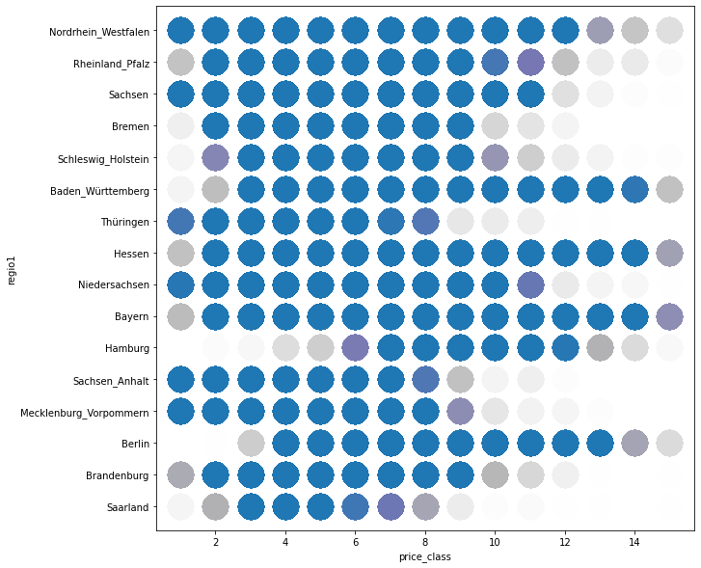
Data immoscout24.de

Slide 35
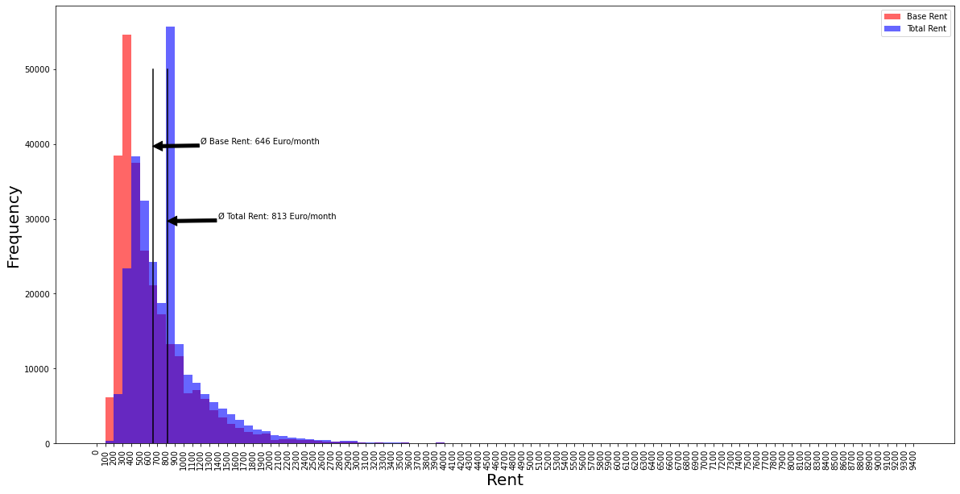
Data immoscout24.de

Slide 36
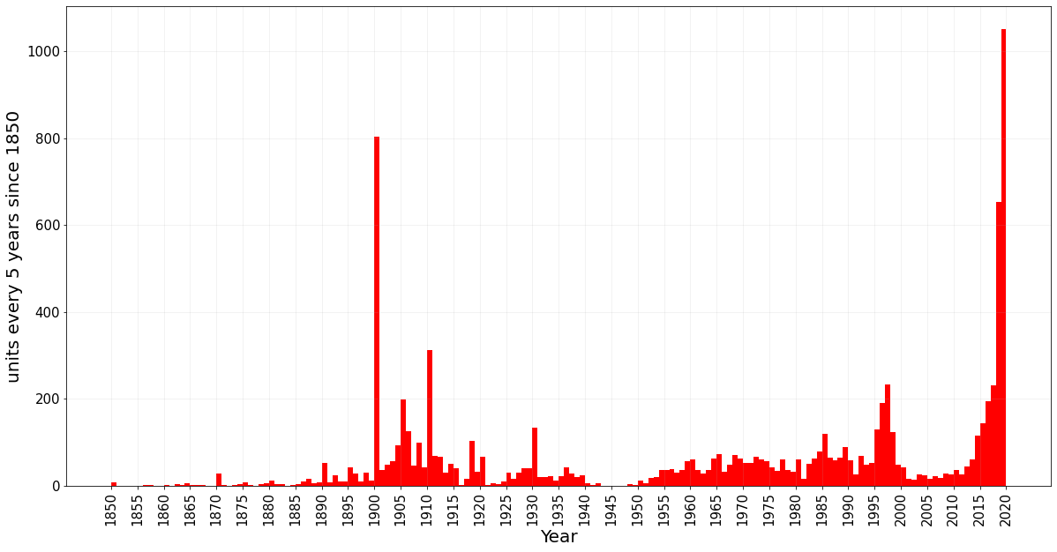
Data immoscout24.de

